Slide 1
Python DTS PRoA 2022 Library Session: Miscellaneous (Telegram BOT)
Muhammad Ogin Hasanuddin
KK Teknik Komputer
Sekolah Teknik Elektro dan Informatika
Institut Teknologi Bandung

Slide 2
Pendahuluan
Bot adalah kependekan dari “robot” yang dapat diartikan sebagai sistem untuk melakukan tugas tertentu secara otomatis dan repetitif. Karena bot beroperasi secara otomatis, mereka dapat bekerja jauh lebih cepat dibandingkan manusia. Selain itu, bot dapat berjalan setiap waktu tanpa harus menunggu manusia mengoperasikannya secara manual.
Ada beberapa bot yang dapat membantu pekerjaan manusia, contohnya seperti web crawler dan chatbot. Sementara itu, ada juga bot yang buruk dan digunakan untuk tindak kejahatan, contohnya seperti malicious bot.
Bot telegram adalah aplikasi pihak ketiga yang berjalan di dalam Telegram. Pengguna dapat berinteraksi dengan bot dengan mengirimi mereka pesan, perintah, dan permintaan sebaris. Anda mengontrol bot Anda menggunakan permintaan HTTPS ke Bot API Telegram.
Notes:
Referensi: https://www.dicoding.com/blog/apa-itu-bot/

Slide 3
How do I create a bot?
BotFather is the one bot to rule them all. It will help you create new bots and change settings for existing ones.

Slide 4
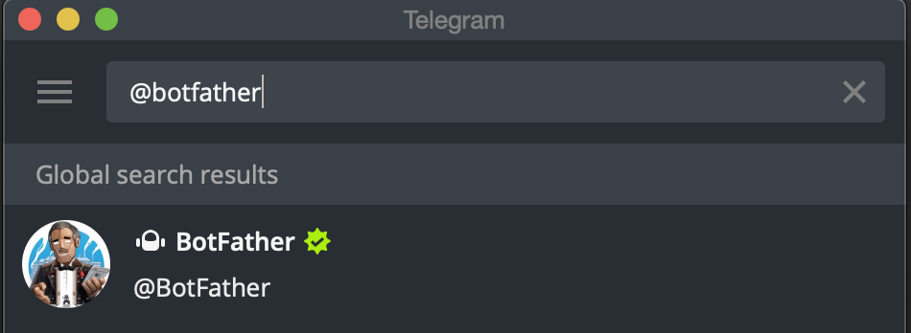
Set up your Bot’s profile
To set up a new bot, start the conversation with BotFather (@BotFather). BotFather will help us in creating the new bot.
Search for @botfather in Telegram.
Notes:
https://www.codementor.io/@karandeepbatra/part-1-how-to-create-a-telegram-bot-in-python-in-under-10-minutes-19yfdv4wrq

Slide 5
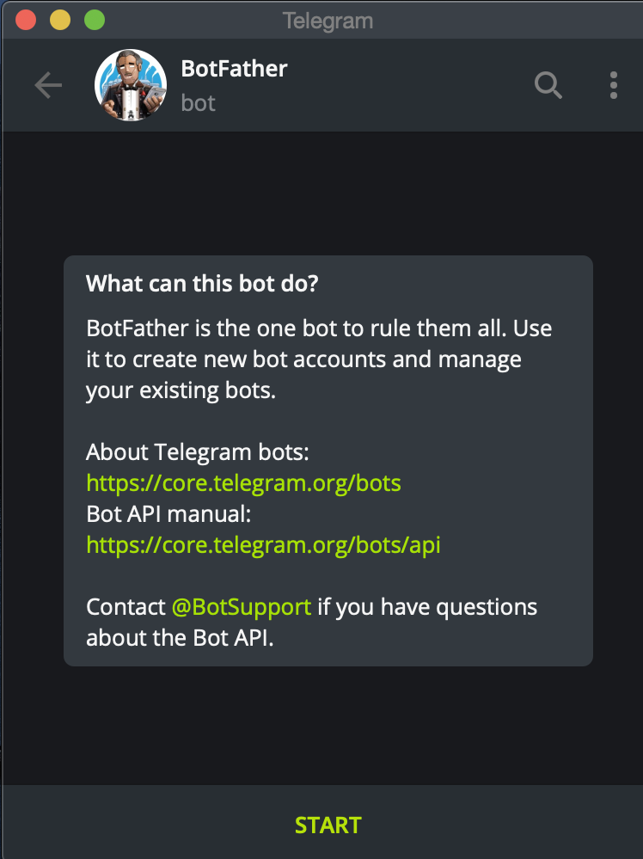
Start your conversation by pressing the Start button.

Slide 6
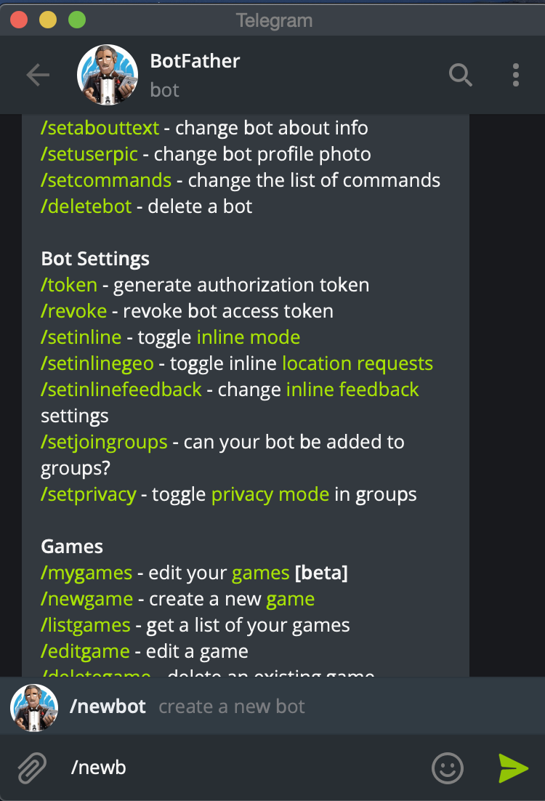
Create the bot by running /newbot command

Slide 7
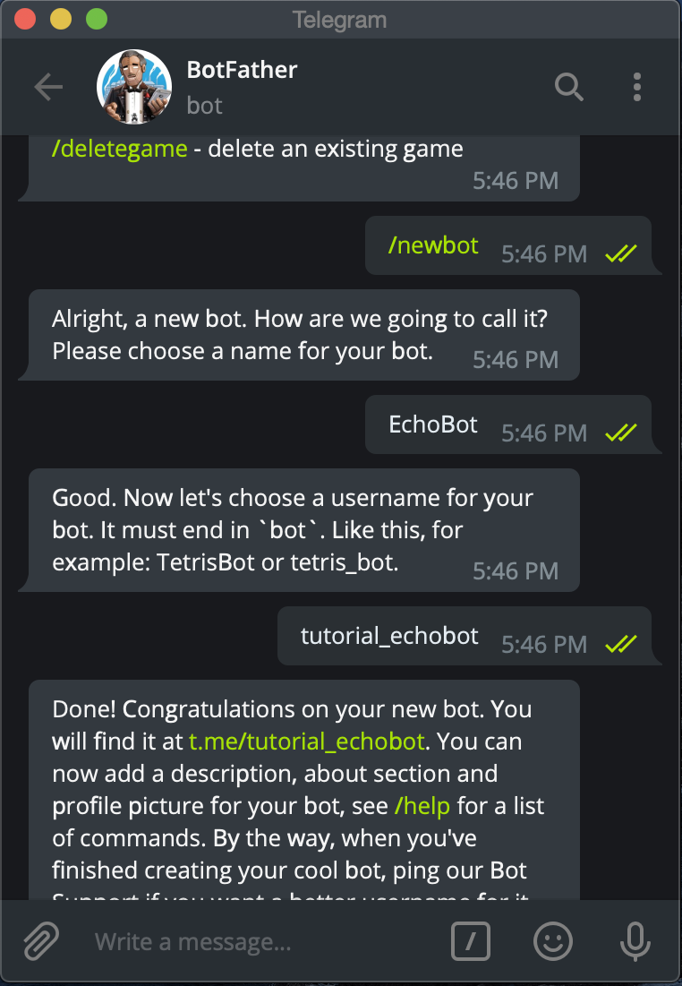
Enter the Display Name and User Name for the bot.

Slide 8
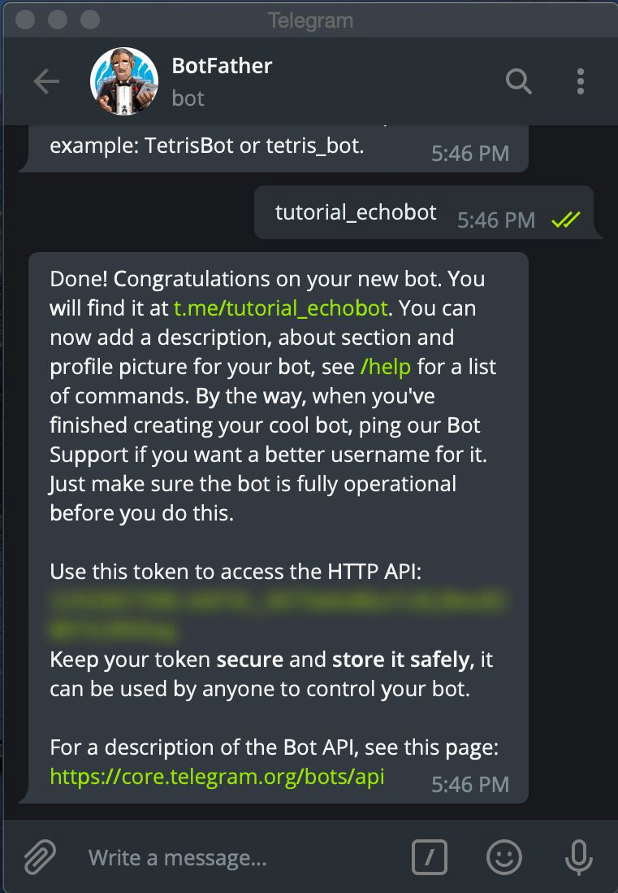
BotFather will send you a message with the token

Slide 9

Note
Keep access token of the bot securely.
Anyone with your token can manipulate this bot.

Slide 10
Coding the bot
Open up the terminal and start by creating a new directory first.
$ mkdir note-bot
$ cd note-bot/

Slide 11
Setup virtual environment
To create a virtual environment, go to your project’s directory and run venv. If you are using Python 2, replace venv with virtualenv in the below commands.
The second argument is the location to create the virtual environment. Generally, you can just create this in your project and call it env.
venv will create a virtual Python installation in the note-bot-venv folder.
$ py -m venv note-bot-venv
Note: You should exclude your virtual environment directory from your version control system using .gitignore or similar.

Slide 12
Activating a virtual environment
Before you can start installing or using packages in your virtual environment you’ll need to activate it. Activating a virtual environment will put the virtual environment-specific python and pip executables into your shell’s PATH.
$ .\note-bot-venv\Scripts\activate

Slide 13
Install the package using the following command.
$ python -m pip install python-telegram-bot

Slide 14
Freezing dependencies
Pip can export a list of all installed packages and their versions using the freeze command:
Which will output a list of package specifiers such as:
$ python -m pip freeze
APScheduler==3.6.3
cachetools==4.2.2
certifi==2021.10.8
python-telegram-bot==13.11
pytz==2022.1
pytz-deprecation-shim==0.1.0.post0
six==1.16.0
tornado==6.1
tzdata==2022.1
tzlocal==4.2

Slide 15
Create a new file bot.py and paste the following code in it.
https://github.com/muhammadoginh/library-session-2022.git, cek library session 5

Slide 16
Run the bot
$ python bot.py

Slide 17
Deploying Telegram Bot on Heroku

Slide 18
Setting up Heroku
First things first, you will need to create an account on Heroku.
Install heroku-cli for your specific operating system.
Login in to your account by running the following command in terminal
$ heroku login -i
Notes:
https://www.codementor.io/@karandeepbatra/part-2-deploying-telegram-bot-for-free-on-heroku-19ygdi7754

Slide 19
Code Changes
Sebelumnya kita menggunakan polling untuk menjalankan bot. Untuk mendeploy bot secara online, kita akan menggunakan webhook, sehingga perlu beberapa perubahan pada kode sebelumnya.

Slide 20
Deploying the application
we will first need to make this directory as a git repository before pushing the code to Heroku. Use the following command to instantiate your current directory as a git repository.
Create the Heroku application using the following command, you can use whatever “app_name” you like.
Now you can use this Heroku application link in the APP_NAME in the code above. (In my case APP_NAME is “https://note-bot-demo.herokuapp.com/”)
$ git init
$ heroku create "app_name"

Slide 21
Remote URL of the application
Once the app is created, you can check the Remote URL of the application. Run the following command to check the emote information.
Now we need to tell our application what command to run on startup, for that Heroku uses a file called Procfile. You can read more about Procfile here.
$ git remote -v

Slide 22
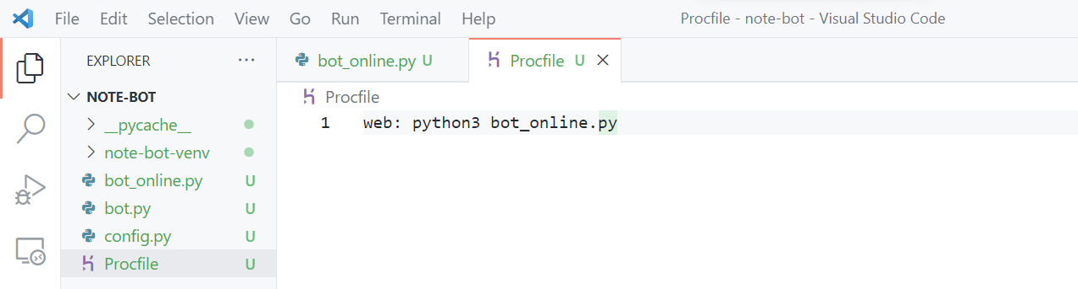
Create a file named “Procfile”.

Slide 23
Tell the dependencies to install on the Heroku server
Pip can export a list of all installed packages and their versions using the freeze command:
$ python -m pip freeze > requirements.txt

Slide 24
Last part
you just need to add the files, commit it and push those changes to Heroku. For our changes, we can add all the files in the git repo. So run the following command.
Give commit
Push
Now your application will start its build, you can check the logs by running the following command.
$ git add .
$ git commit –m “pesan”
$ git push heroku master
$ heroku logs -t

Slide 25
Referensi
https://github.com/python-telegram-bot/python-telegram-bot/wiki/Webhooks#heroku
https://github.com/python-telegram-bot/python-telegram-bot/wiki/Extensions-%E2%80%93-Your-first-Bot
Link github code library session 1-5: https://github.com/muhammadoginh/library-session-2022.git

Slide 26
Terimakasih!

